Slide 1
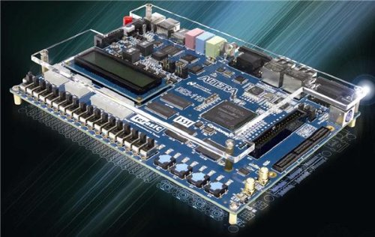

ELEC 4511
Hardware Software Design
Lecture 18: Customize AXI IP

Slide 2

Customize AXI IP
In last lecture, we wrote C code in SDK and used Xilinx AXI GPIO core to turn on and off LED. From that lecture, you would have already known AXI GPIO is a “Verilog module”. And the ARM processor controls the module via AXI bus.
This lecture, you will design your own IP to control the LED.

Slide 3
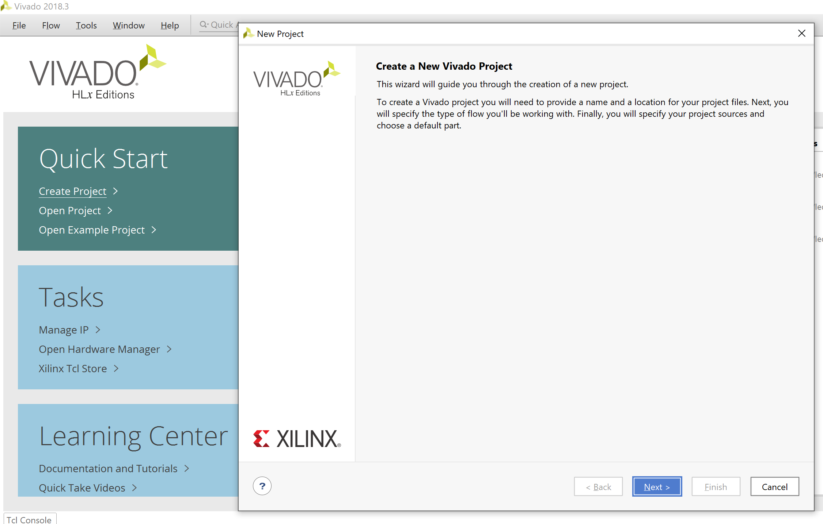
Customize AXI IP
Create a new Project.

Slide 4
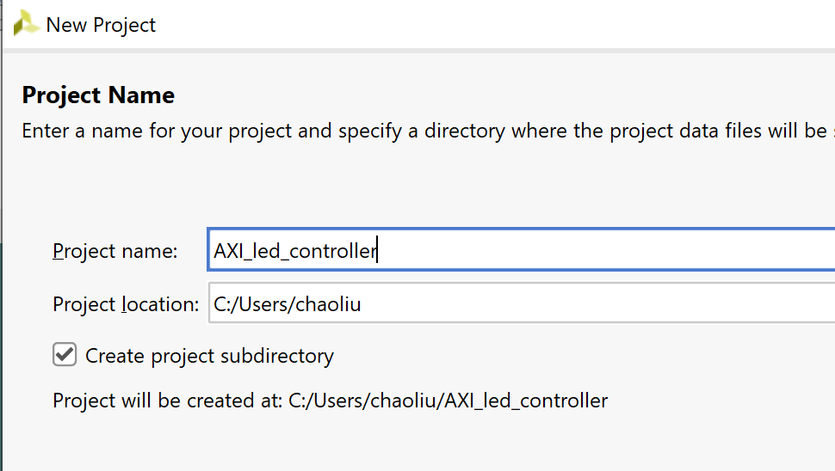
Customize AXI IP
Project_name : AXI_led_controller

Slide 5
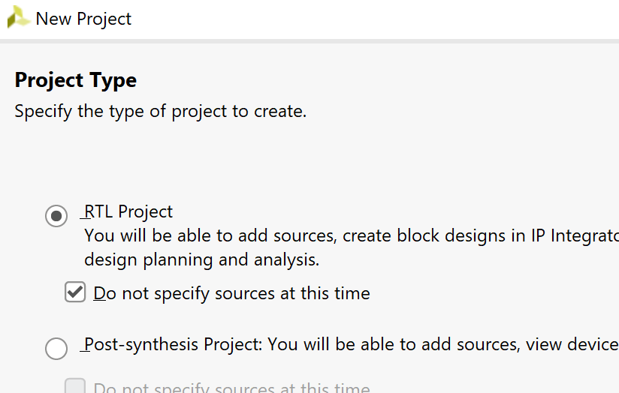
Customize AXI IP
Choose RTL Project.

Slide 6
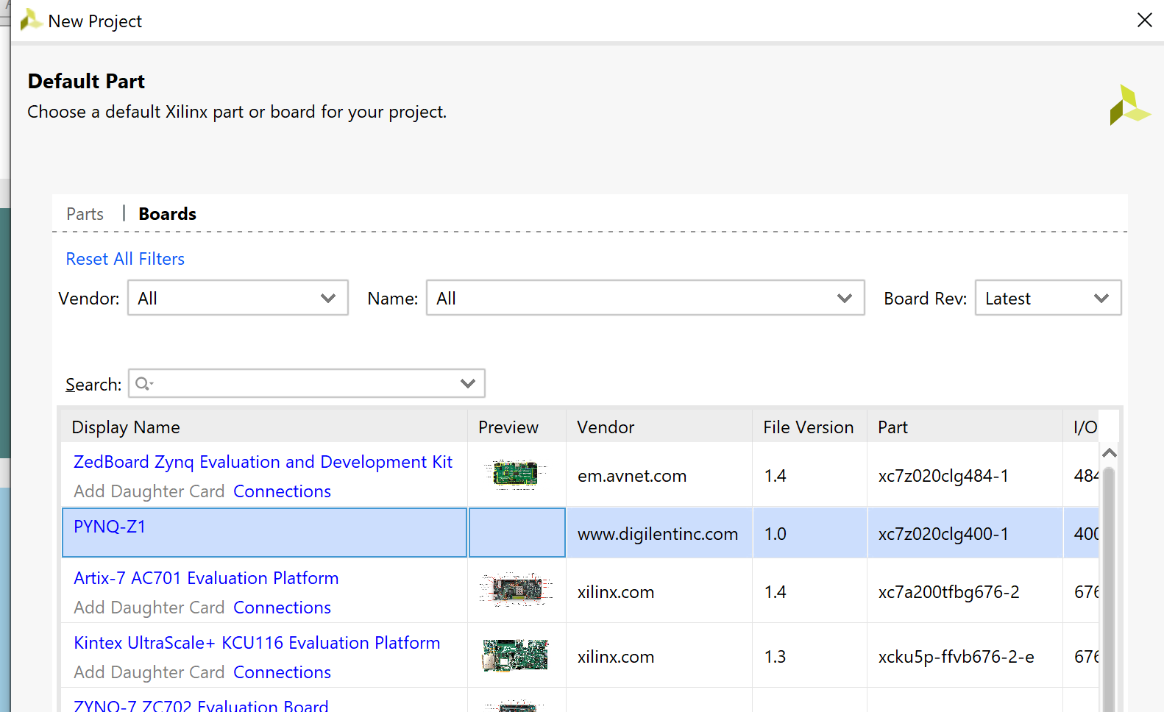
Customize AXI IP
Click “Boards” and select “PYNQ-Z1”

Slide 7
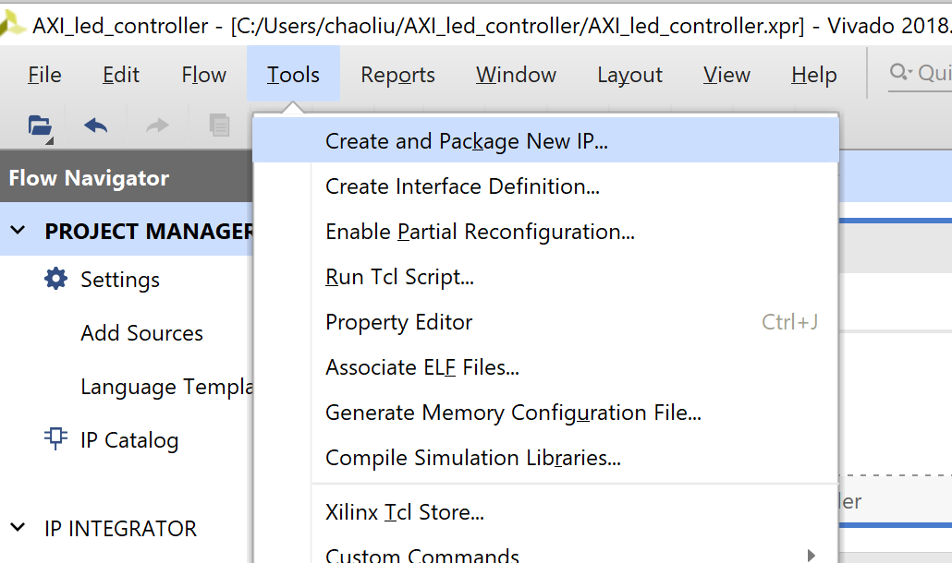
Customize AXI IP
Tools → Create and Package New IP

Slide 8
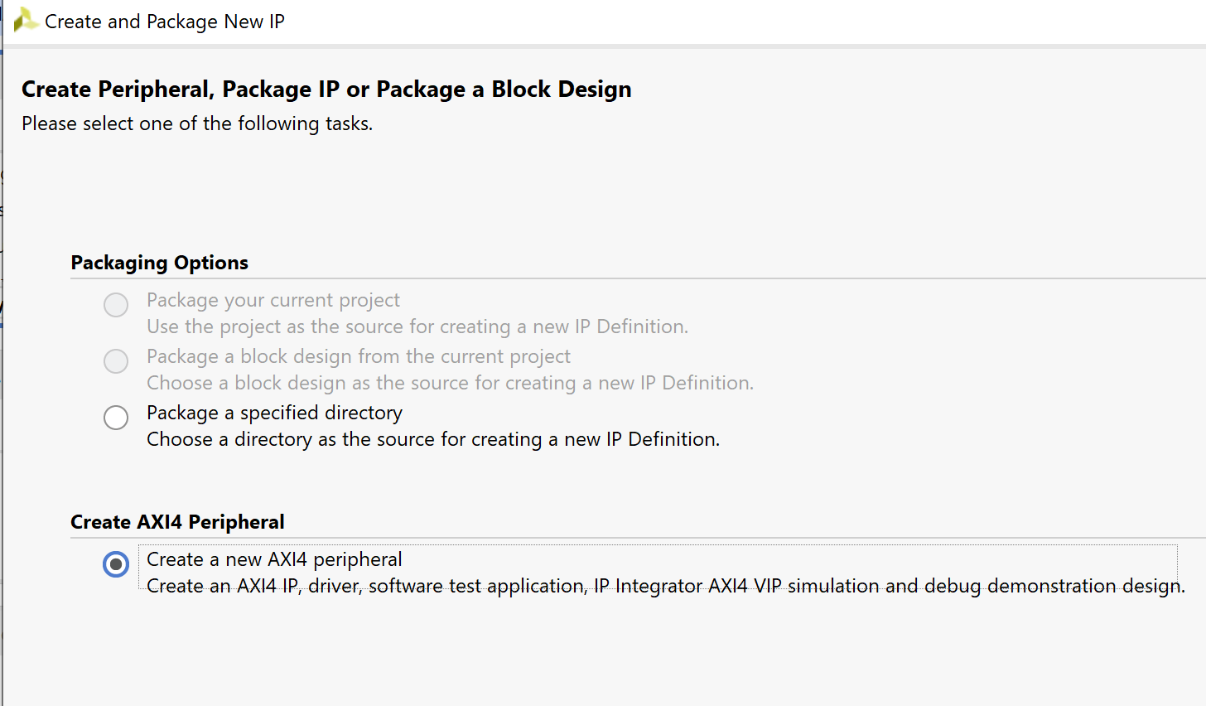
Customize AXI IP
Click on ”Next” and select “Create a new AXI4 Peripheral”

Slide 9
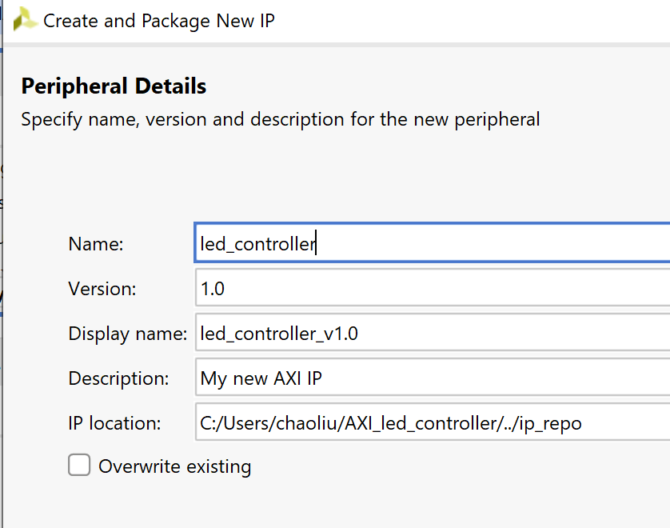
Customize AXI IP
Give your IP a name : led_controller

Slide 10
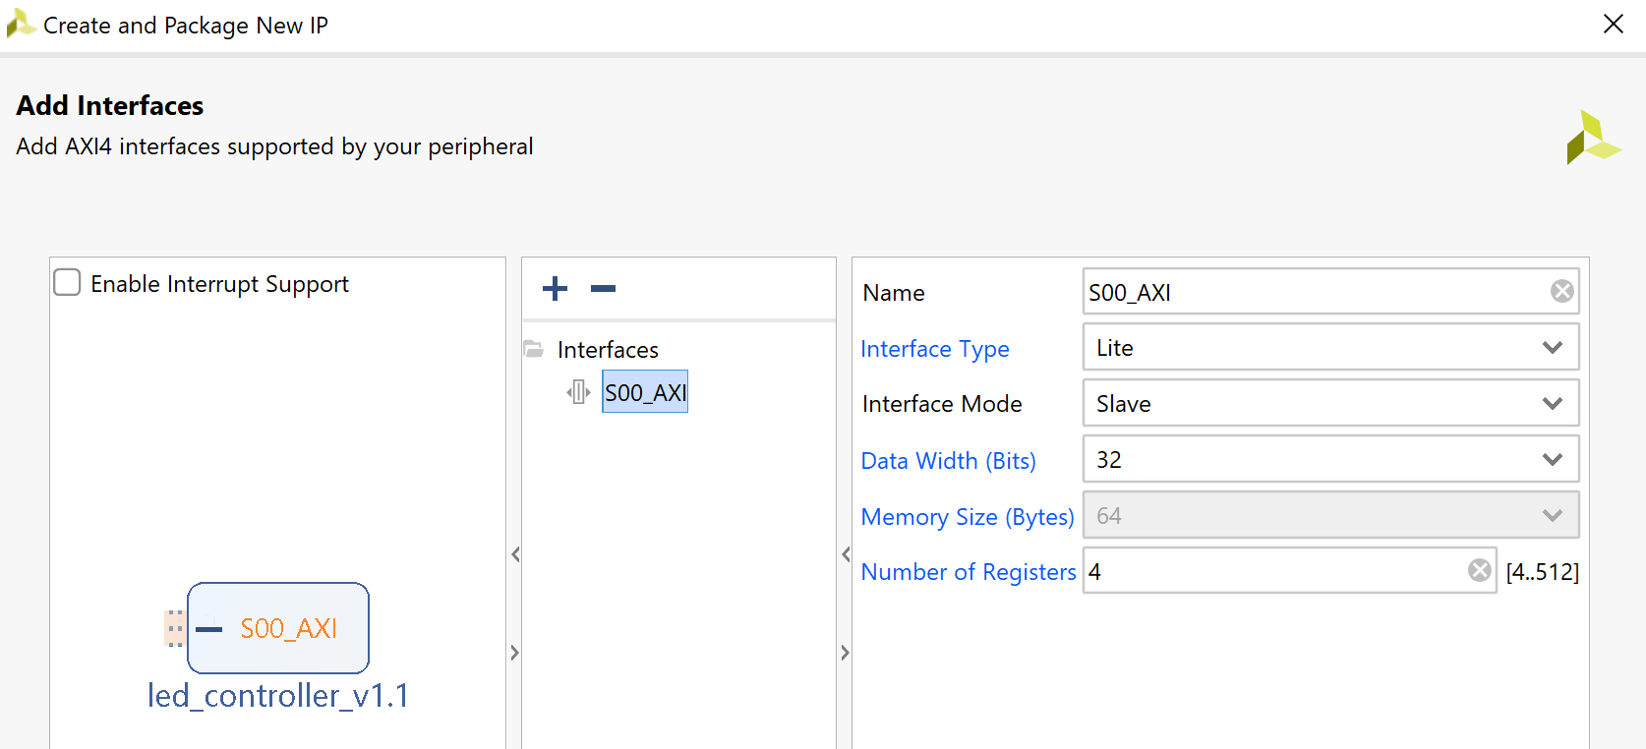
Customize AXI IP
You can choose the default settings on this page. You may find out we choose 4 registers (32 bits for each). However, in our design, we will only use 1. You will see that later
Your version number should be 1.0, since it is your first time to design this led_controller

Slide 11
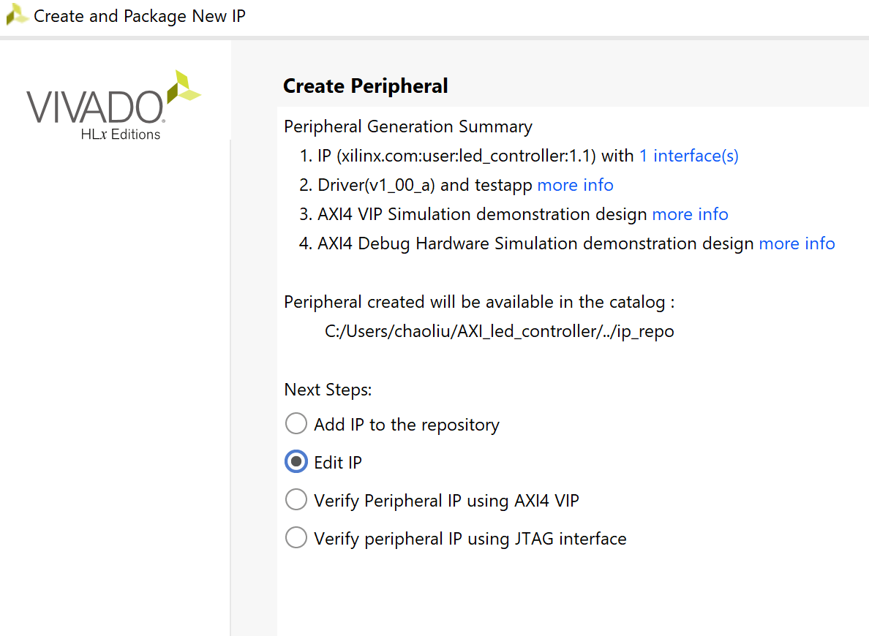
Customize AXI IP
Choose “ Edit IP” and click “Finish”

Slide 12
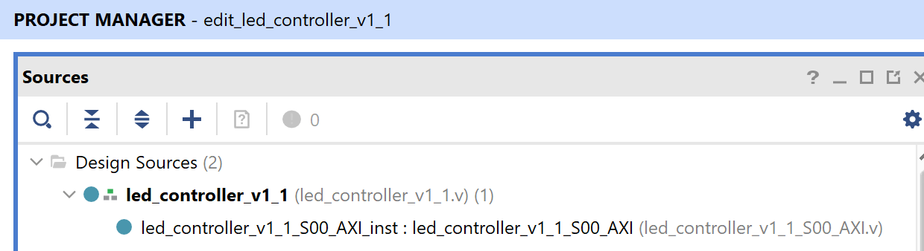
Customize AXI IP
Under Sources, you will find two .v files:
The led_controller_v1_1_S00_AXI.v file contains the AXI bus protocols and your customized design module(your led controller)
And the led_controller_v1_1.v is the top wrapper file of the above one.

Slide 13
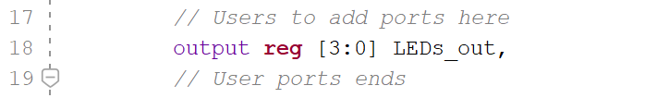
Customize AXI IP
Open led_controller_v1_1_S00_AXI.v file
At line 17, find “// Users to add ports here”.
Add the LEDs_out port here. This port will connect to the pins of LD3 ~ LD0

Slide 14
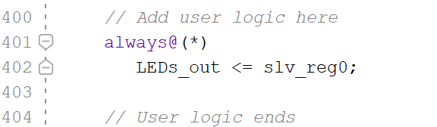
Customize AXI IP
Then at the end of this file, around line 400, find “// Add user logic here”
In the future, you may instantiate your design module here and write your code in another .v file.
However, this time the led controller is a very simple design. So we will directly write the logic code here.

Slide 15
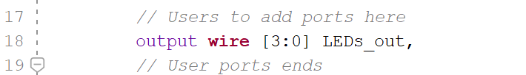
Customize AXI IP
Slv_reg0 is one of the 4 registers you created in slide 10.
PS send/receive data throughout the slave registers on AXI bus. For this design, PS will only send “turn on” or “turn off” signals to LED controller. And LED controller will directly give “high” or “low” voltage to the pins (LD3 ~ LD0)
Then save the file and open “led_controller_v1_1.v ”. At line 17, you will find “users to add ports here”. Please add your LEDs_out port here/

Slide 16
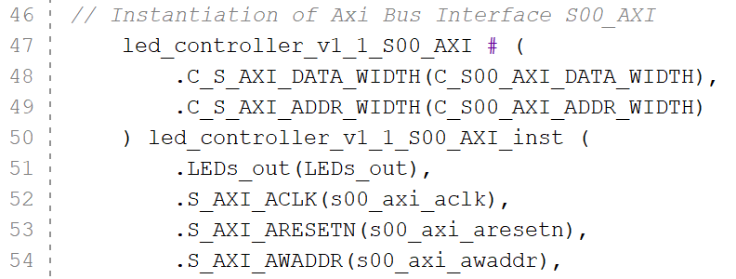
Customize AXI IP
At line 51, modify the original instantiation, since you have modified the led_controller_v1_1_S00_AXI.v . Then save this file

Slide 17
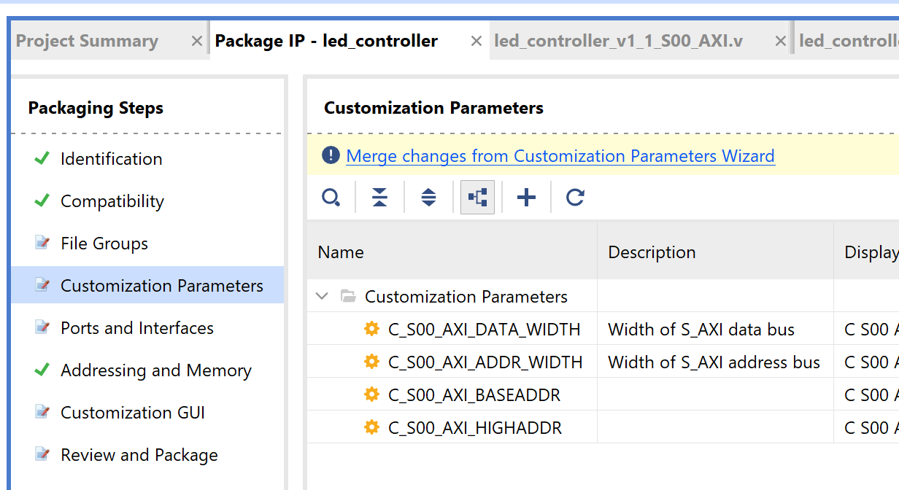
Customize AXI IP
Now you need to update your IP. Click on Merge changes from Customization Parameters Wizard

Slide 18
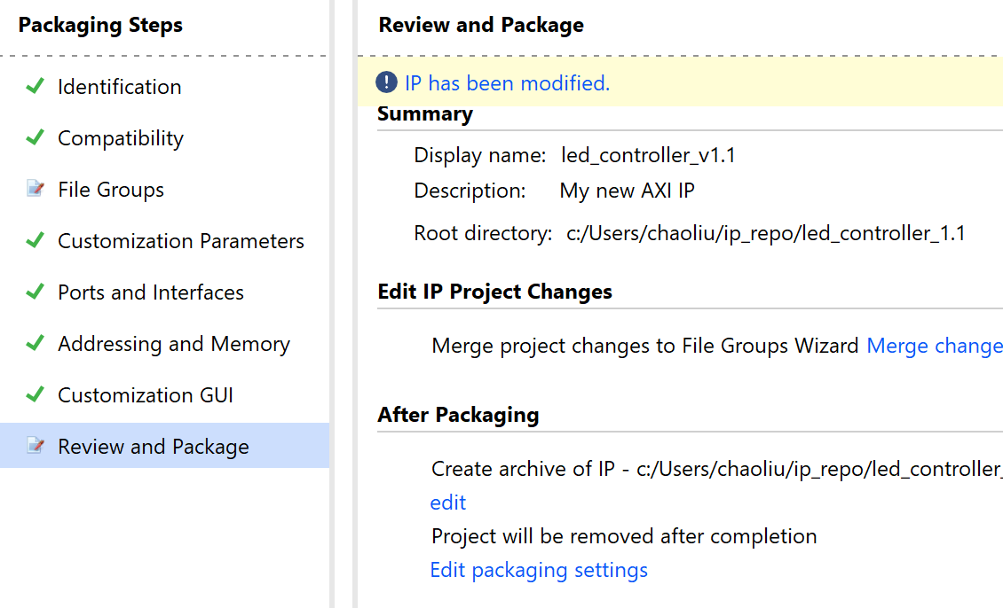
Customize AXI IP
Review and Package → Edit packaging setting

Slide 19
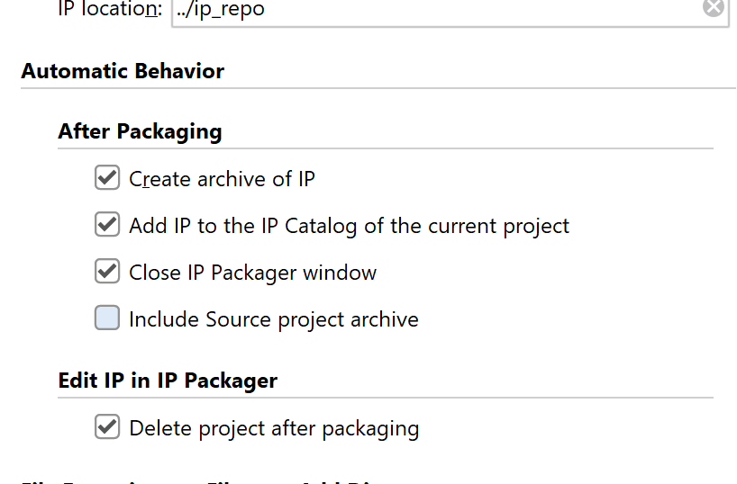
Customize AXI IP

Slide 20
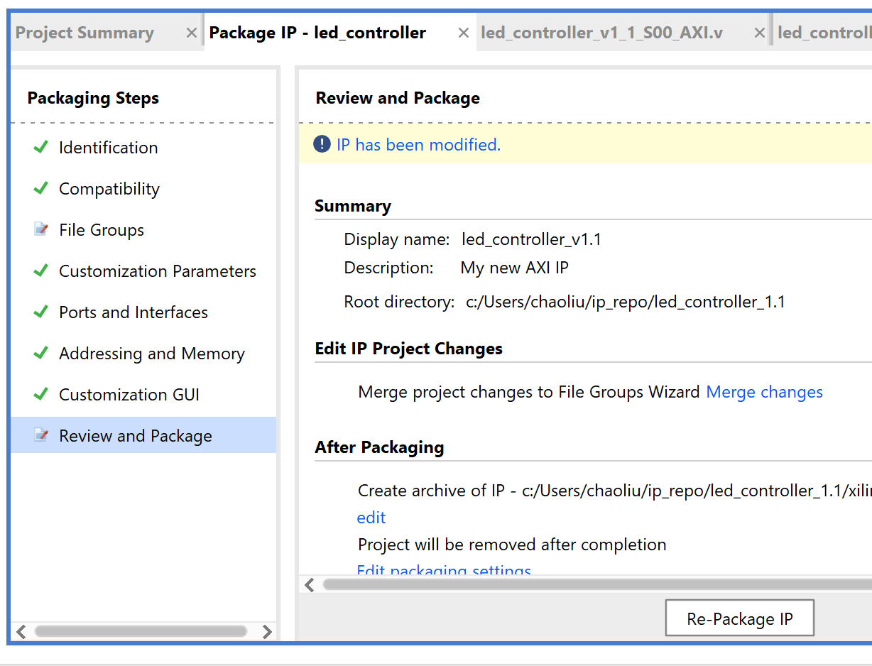
Customize AXI IP
Click OK and then click re-package IP. Then click yes to close the project

Slide 21
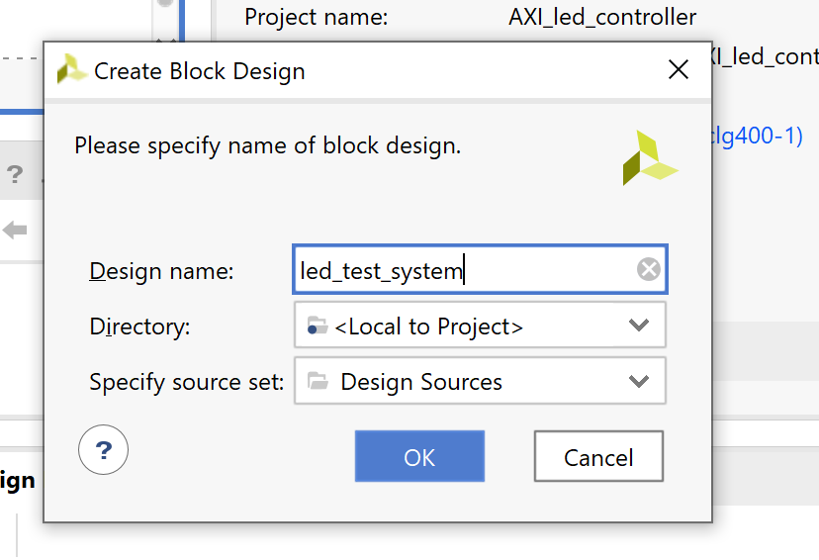
Customize AXI IP
Then create a block design as you did in previous lectures.

Slide 22
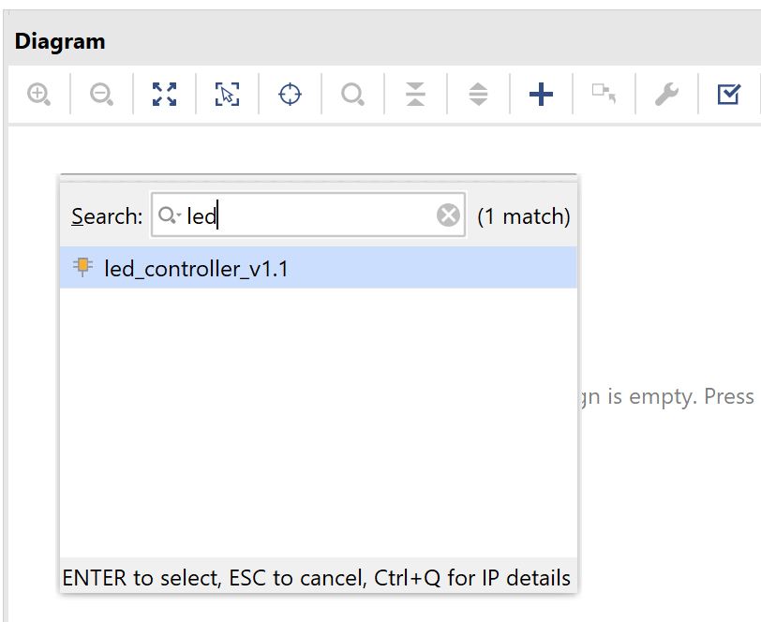
Customize AXI IP
Add IP. Search and find your led_controller

Slide 23
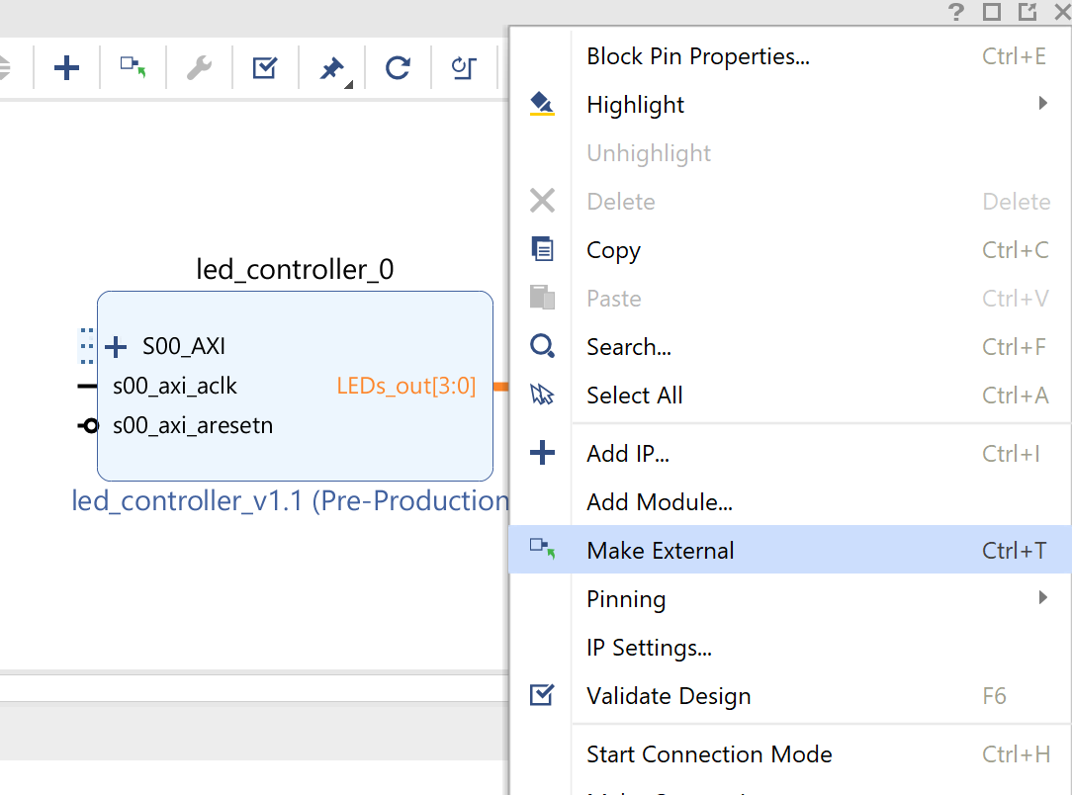
Customize AXI IP
LEDs_out will be an external port to the board. So here click on the LEDs_out and right click it. Choose “make external”

Slide 24
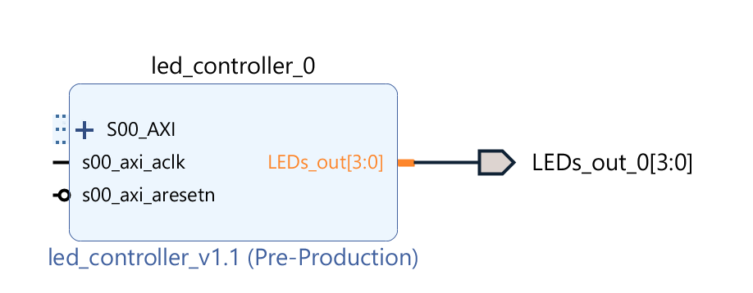
Customize AXI IP
Then add Zynq ps IP and “Run Block Automation” and “Run Connection Automation”

Slide 25
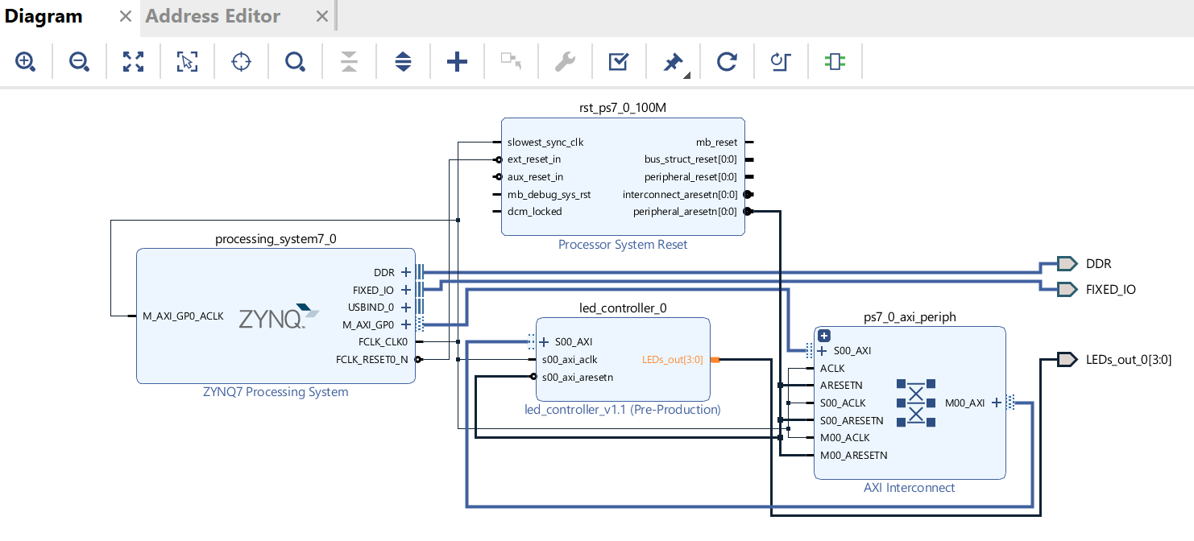
Customize AXI IP
Tools → Validate Design

Slide 26
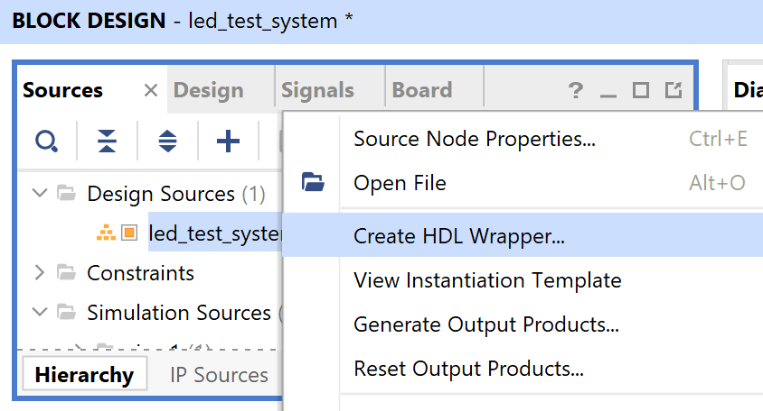
Customize AXI IP
Create HDL Wrapper

Slide 27
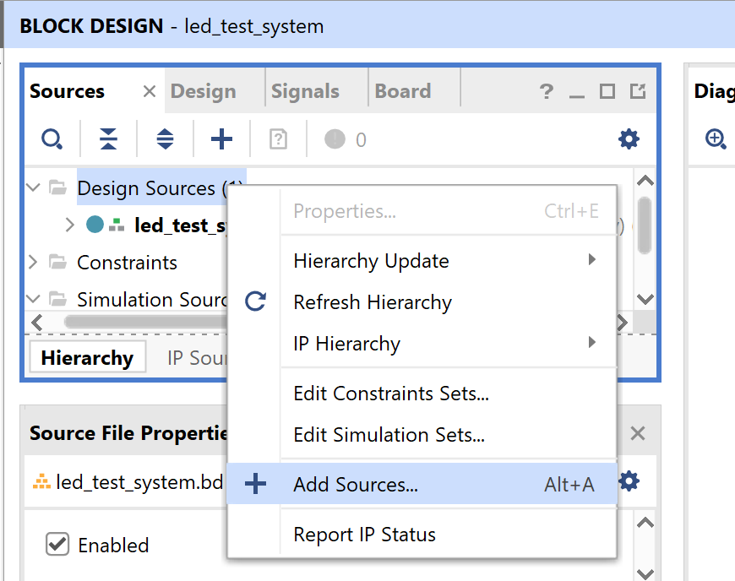
Customize AXI IP
Add pins constraint file for LEDs

Slide 28
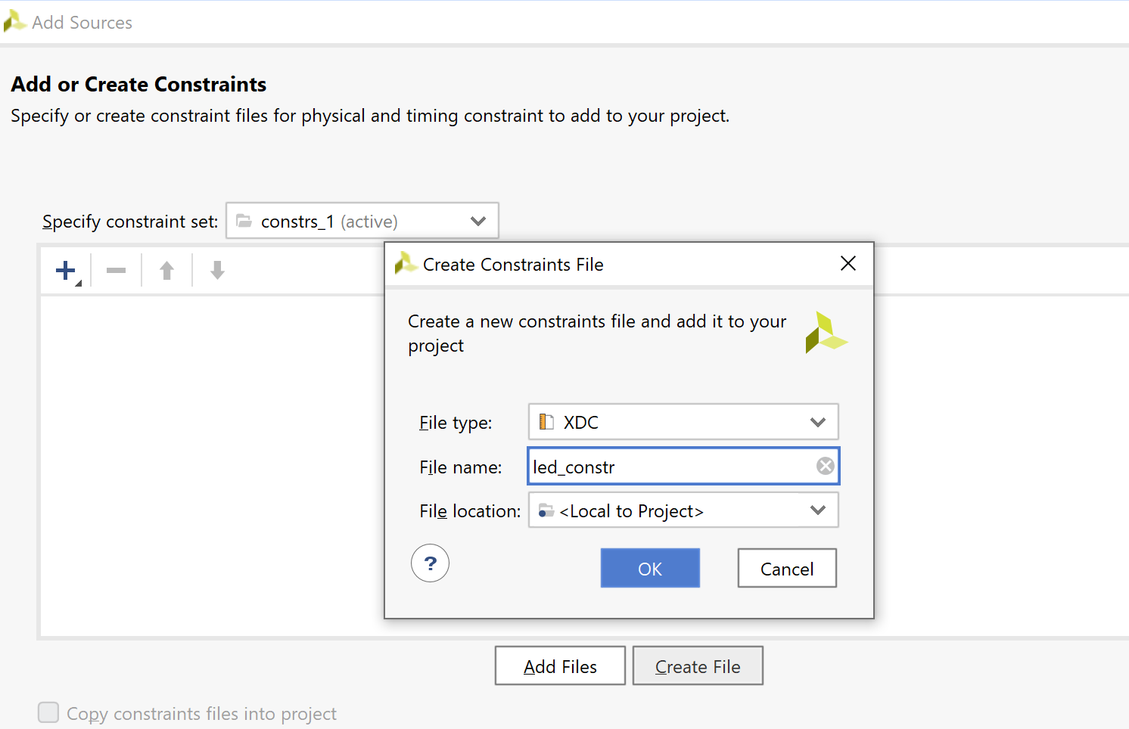
Customize AXI IP
Create a new constraint file

Slide 29
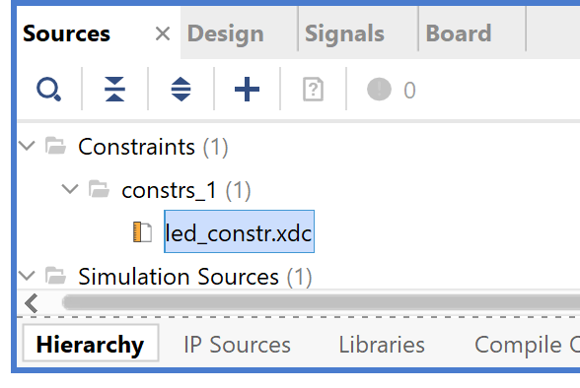
Customize AXI IP
Add pins constraint file for LEDs

Slide 30
Customize AXI IP
Open the XDC file and copy and paste the followings to the file
##LEDs
set_property -dict { PACKAGE_PIN R14 IOSTANDARD LVCMOS33 } [get_ports { LEDs_out_0[0] }]; #IO_L6N_T0_VREF_34 Sch=LEDs_out_0[0]
set_property -dict { PACKAGE_PIN P14 IOSTANDARD LVCMOS33 } [get_ports { LEDs_out_0[1] }]; #IO_L6P_T0_34 Sch=LEDs_out_0[1]
set_property -dict { PACKAGE_PIN N16 IOSTANDARD LVCMOS33 } [get_ports { LEDs_out_0[2] }]; #IO_L21N_T3_DQS_AD14N_35 Sch=LEDs_out_0[2]
set_property -dict { PACKAGE_PIN M14 IOSTANDARD LVCMOS33 } [get_ports { LEDs_out_0[3] }]; #IO_L23P_T3_35 Sch=LEDs_out_0[3]

Slide 31
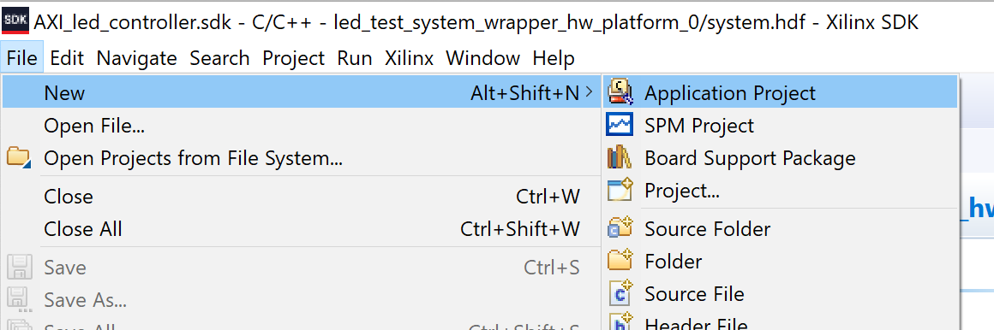
Customize AXI IP
Generate Bitstream
File → Export→ Export Hardware (include bitstream)
File → Launch SDK
In SDK, File → New → Application Project

Slide 32
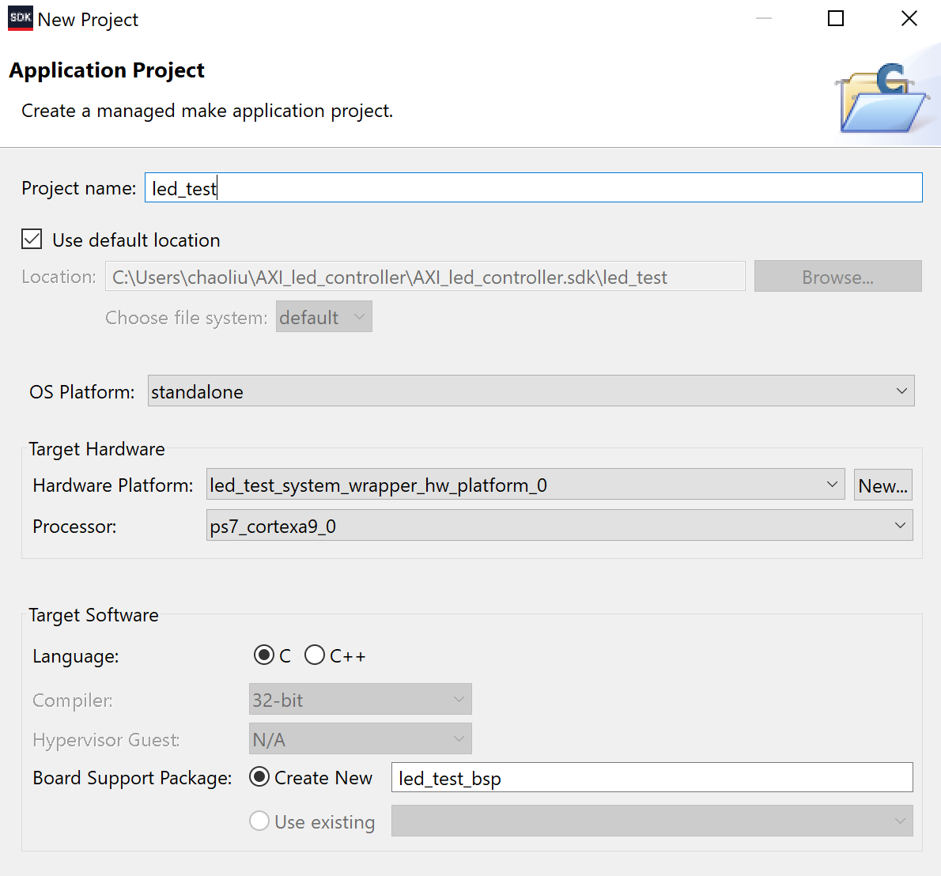
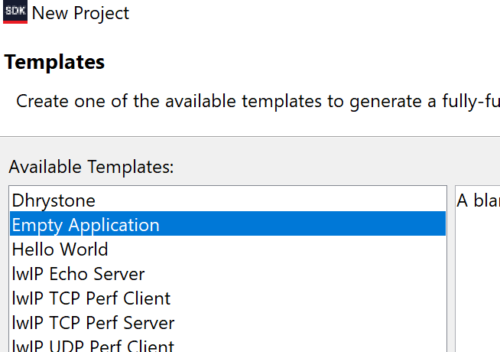
Customize AXI IP
Create an empty C project

Slide 33
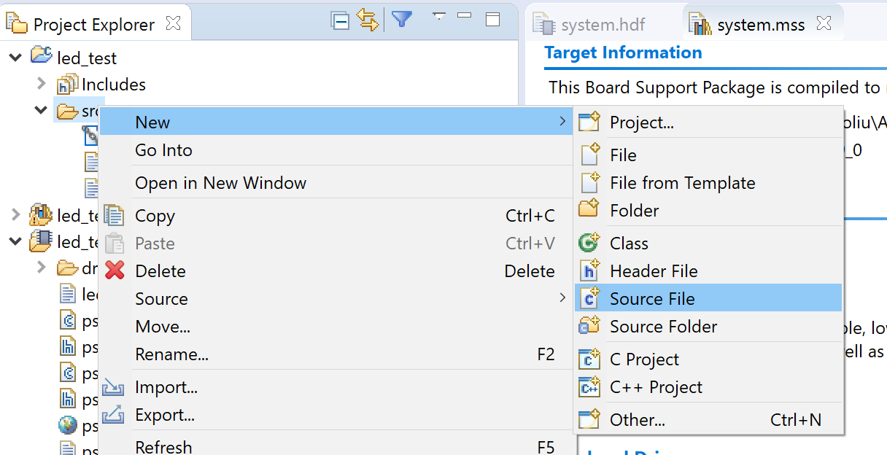
Customize AXI IP
Generate a new C source File

Slide 34
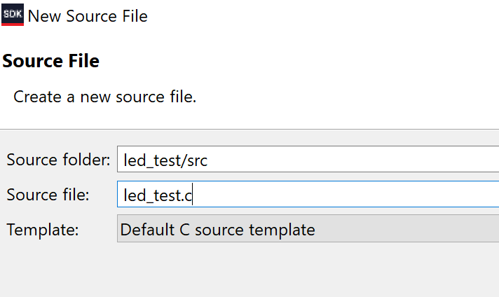
Customize AXI IP
Don’t forget to add .c after your file name.

Slide 35
Customize AXI IP
#include "xparameters.h"
#include "xil_io.h"
#include "AXI_led_controller.h"
#include "xil_printf.h"
#define LED_BASE_ADDR XPAR_AXI_LED_CONTROLLER_0_S00_AXI_BASEADDR
#define LED_REG0 0
#define DELAY 50000000
int main()
{
int temp = 0;
int led_value = 0;
int i = 0;
xil_printf("led_controller ip test\r\n");
xil_printf("----------------------\r\n");
while(1)
{
/* write reg0 */
AXI_LED_CONTROLLER_mWriteReg(LED_BASE_ADDR,LED_REG0,led_value);
/* read reg0 */
temp = AXI_LED_CONTROLLER_mReadReg (LED_BASE_ADDR,LED_REG0);
/* show value */
xil_printf("led = %d",led_value);
xil_printf("\ttemp = %d\r\n",temp);
if(led_value < 15)
led_value++;
else
led_value = 0;
for(i=0;i<DELAY;i++);
}
}

Slide 36
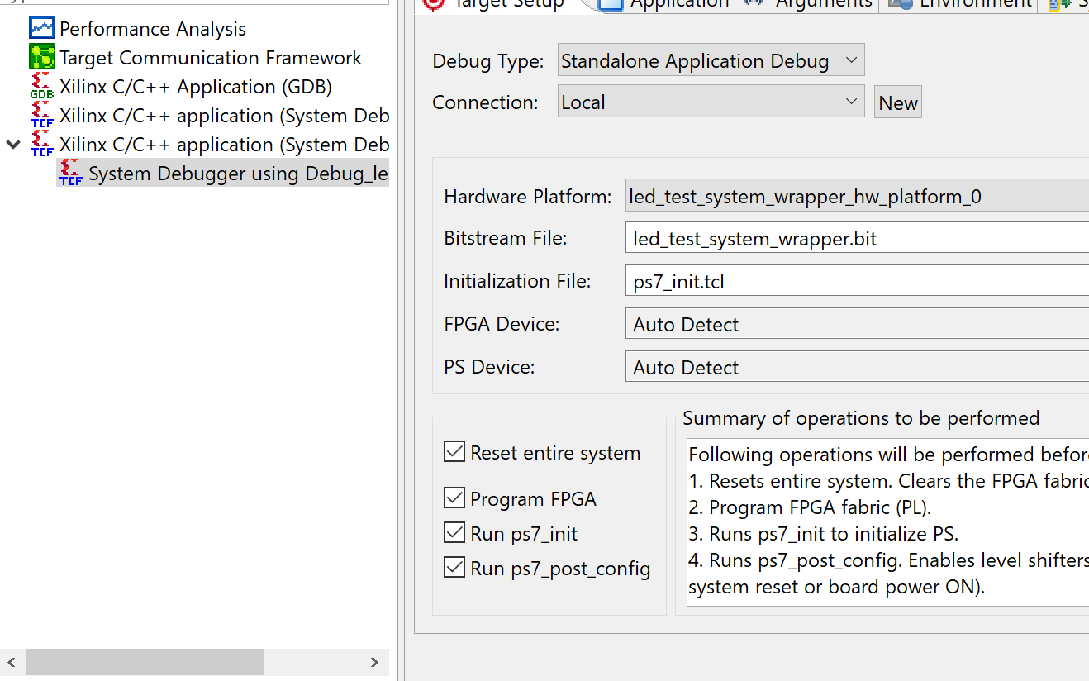
Customize AXI IP

Slide 37
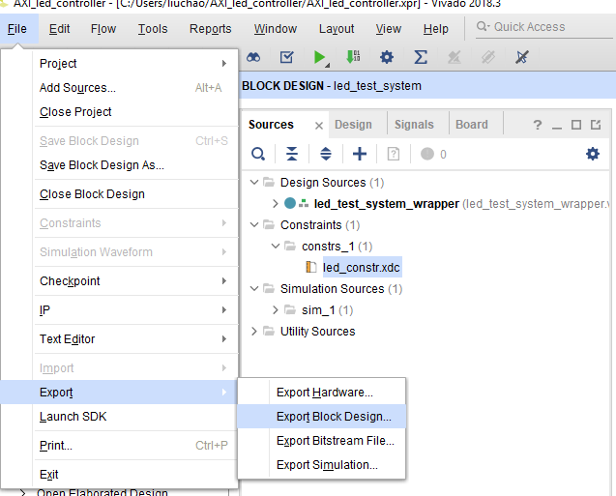
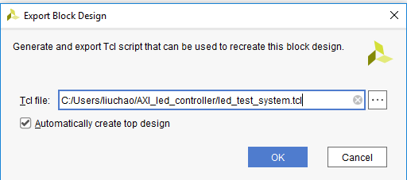
Customize AXI IP
Close SDK
Export Block Design

Slide 38
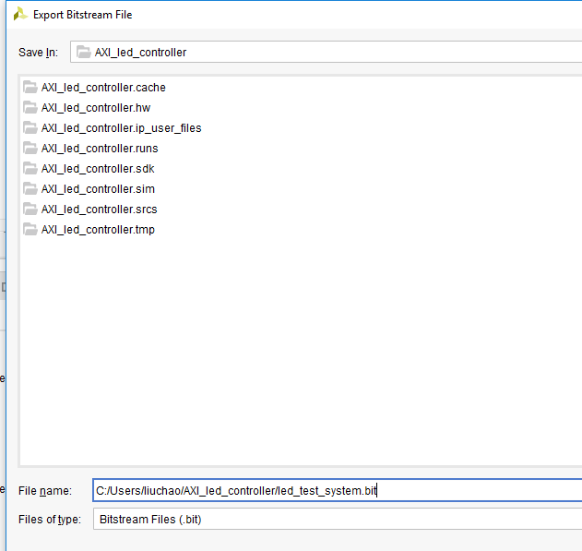
Customize AXI IP
Export Bitstream File
Make sure the bitstream has the same name as the .tcl file

Slide 39
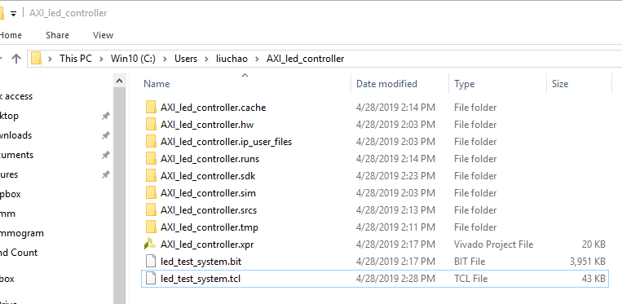
Customize AXI IP
Copy the .bit and .tcl to your pynq board

Slide 40
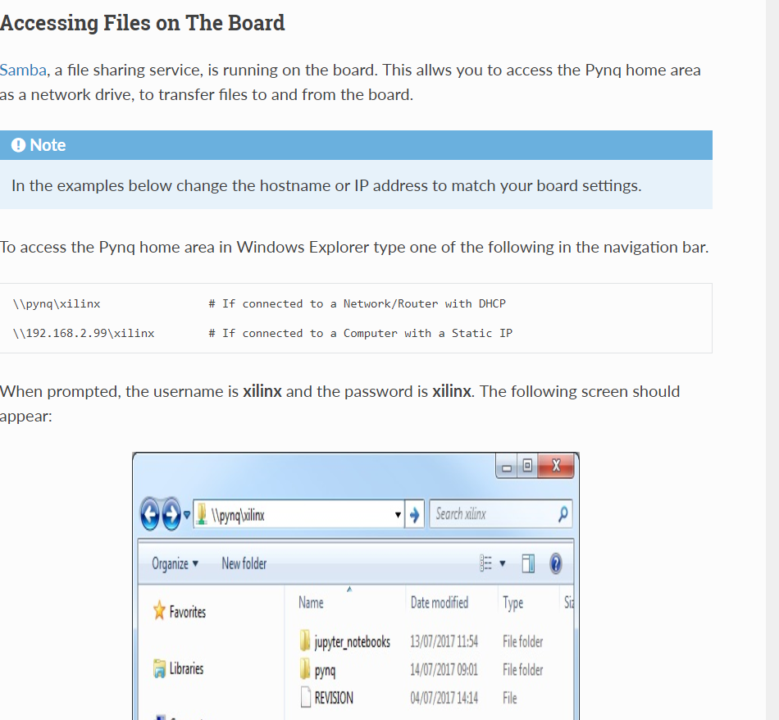
Customize AXI IP
Copy the .bit and .tcl to your pynq board:
First, connect your pynq board with your PC via Ethernet. (static IP). Don’t forget to move your jumper.
Type in \\192.168.2.99\xilinx in your File Explorer.
(reference:
https://pynq.readthedocs.io/en/v2.0/getting_started.html)

Slide 41
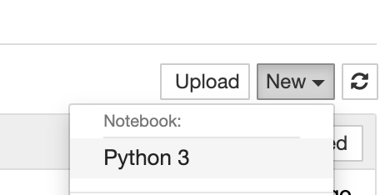
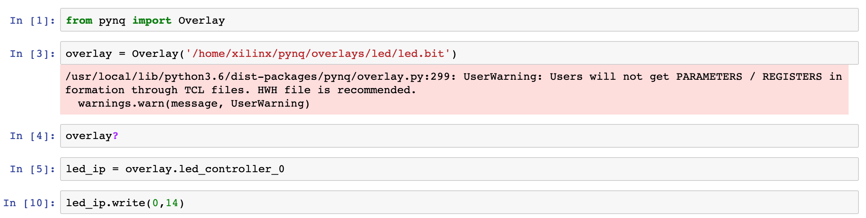
Customize AXI IP
Copy the .bit and .tcl to pynq/overlays/led
(You may create a folder “led”)
Create a new python 3 notebook and type in the code

